Slide 1
Background
There are 12 different types of medications to lower blood sugar levels in patients with type 2 diabetes.
It is widely agreed upon that metformin is the best first-line agent. After metformin, lots of controversy!
CV disease is a major problem in patients with diabetes.
Blood sugar lowering by itself has either no or little effect on decreasing CV events.
We have been searching for decades for a diabetes medicine that will not only lower blood sugar - but also reduce CV complications.
Based on FDA guidelines, all new diabetes medicines need to be tested for CV safety.

Slide 2
SGLT-2 Inhibitors
This newest class of diabetes medications lower blood sugar by getting rid of sugar through the urine.
The risk of hypoglycemia is not increased.
These drugs also lower blood pressure and weight loss.
Could the SGLT2 inhibitors be the drug category that finally reduces CV complications?
All other drugs have failed to demonstrate this convinicingly (with the possible exception of metformin.)
We studied the SGLT2 inhibitor, empagliflozin, in a large CV outcome trial, EMPA-REG OUTCOME.

Slide 3
EMPA-REG OUTCOME® Trial design
Placebo (n=2333)
Screening
(n=11531)
Randomized and treated
(n=7020)
Empagliflozin 10 mg
(n=2345)
Empagliflozin 25 mg
(n=2342)
Study medication was given in addition to standard of care.
Key inclusion criteria:
Adults with type 2 diabetes and CV disease (heart attack, stroke, etc.)
HbA1c 7–10%; eGFR ≥30 mL/min/1.73m² (MDRD)
1° outcome = ‘3-point MACE’ (CV death, non-fatal MI, non-fatal stroke)

Slide 4
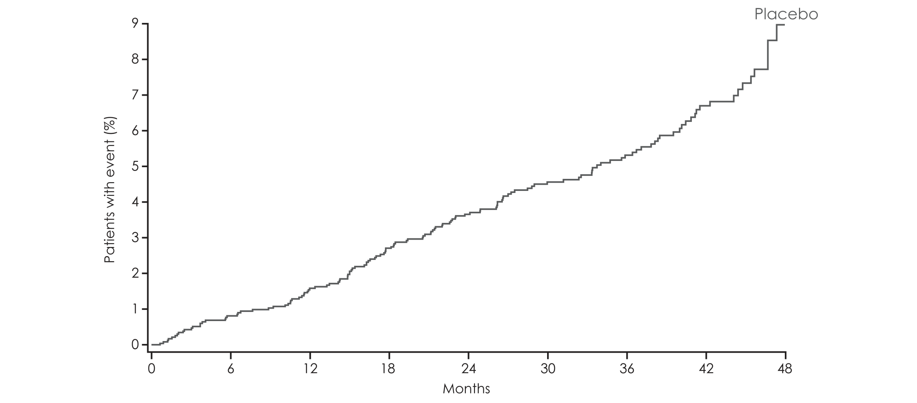
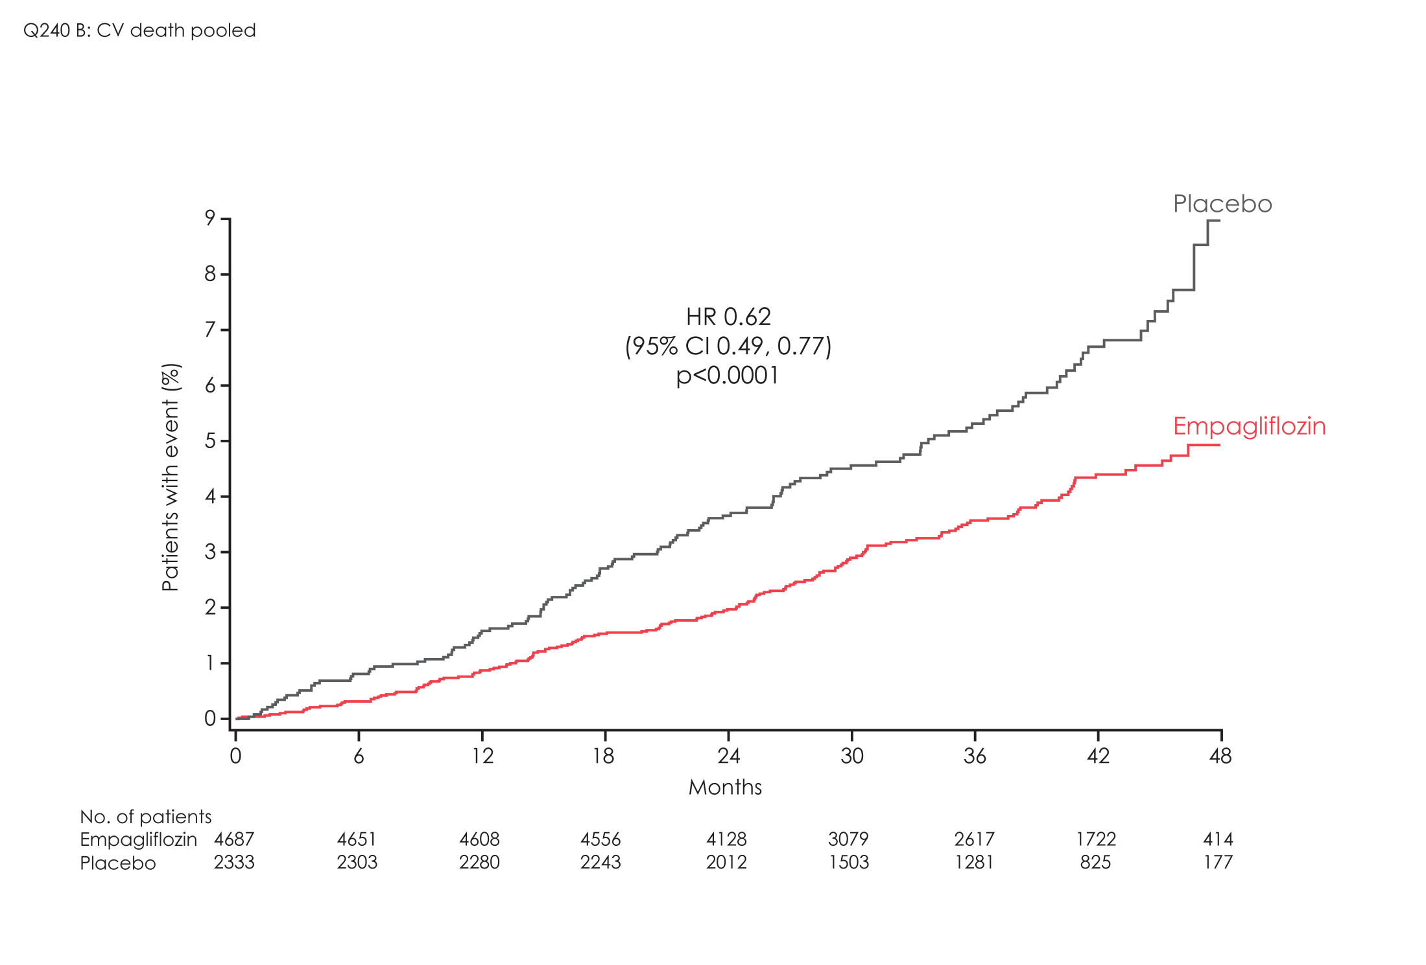
EMPA-REG OUTCOME: Cardiovascular death
HR 0.62
(95% CI 0.49, 0.77)
p=0.0001
38%
N=7020
Zinman B et al. N Engl J Med 2015, published on-line, 9-1-15, DOI:10.1056/NEJMoa1504720

Slide 5
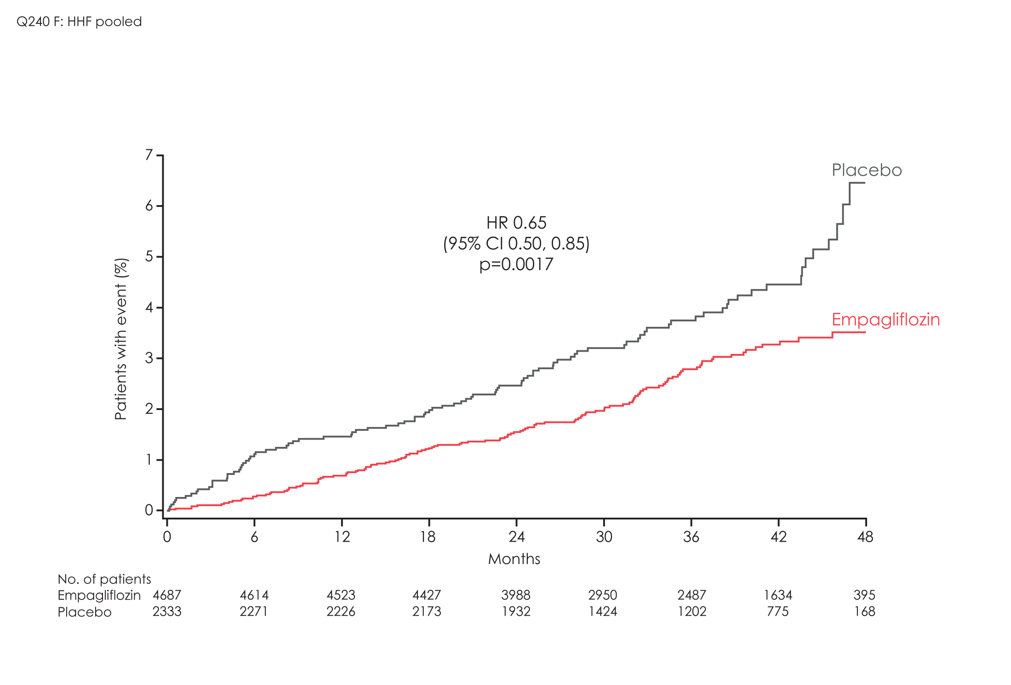
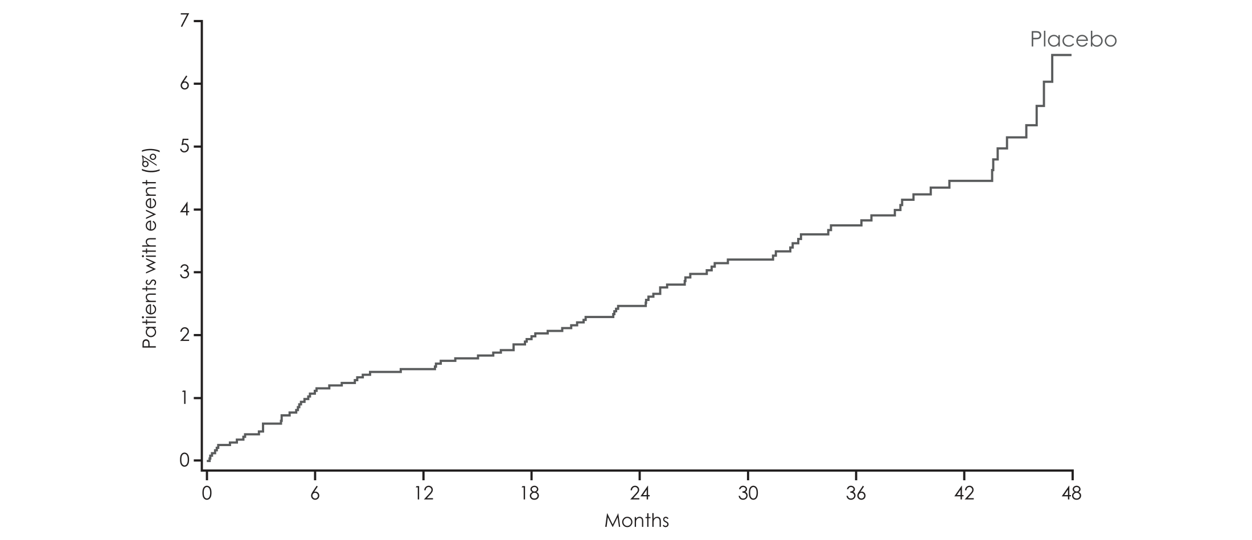
EMPA-REG OUTCOME: Hospitalization for heart failure
HR 0.65
(95% CI 0.50, 0.85)
p=0.0017
35%
N=7020
Zinman B et al. N Engl J Med 2015, published on-line, 9-1-15, DOI:10.1056/NEJMoa1504720

Slide 6
Heart failure hospitalization or CV death
EMPA-REG OUTCOME: Hospitalization for heart failure or CV death
HR 0.66
(95% CI 0.55, 0.79)
P<0.0001
34%
Cumulative incidence function. CV, cardiovascular; HR, hazard ratio; CI, confidence interval.

Slide 7
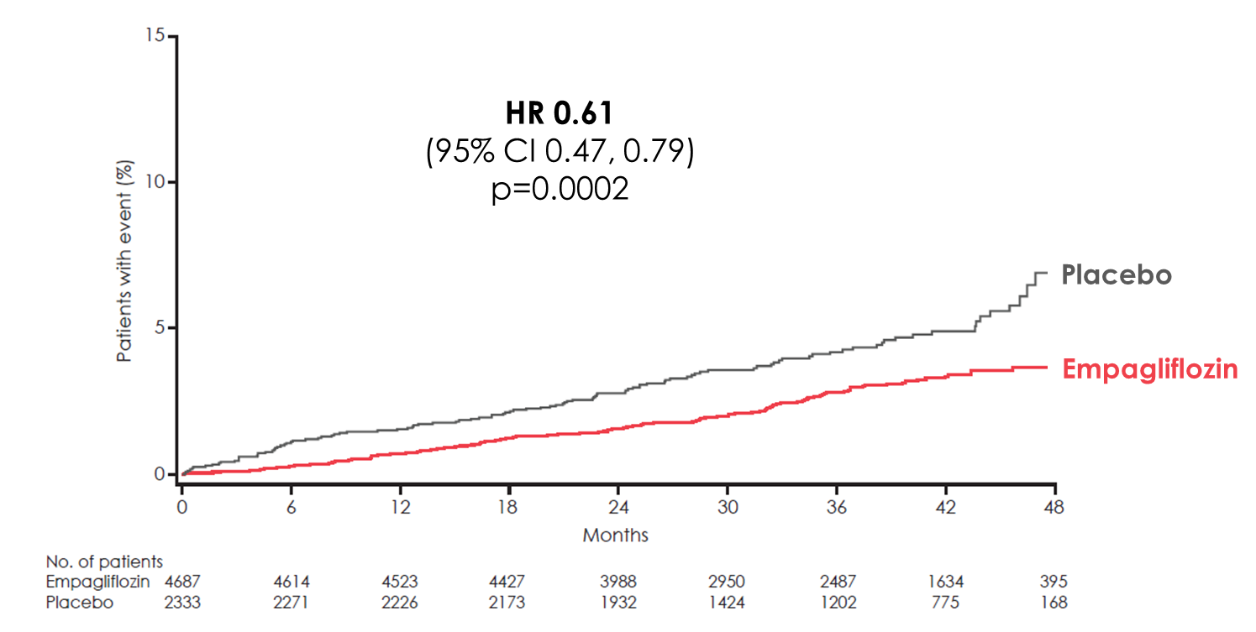
EMPA-REG OUTCOME: Hospitalization or death from heart failure
HR 0.61
(95% CI 0.47, 0.79)
p=0.0002
39%
Cumulative incidence function. HR, hazard ratio; CI, confidence interval.

Slide 8
Hospitalization for heart failure in patients with vs. without heart failure @baseline
HR 0.59
(95% CI 0.43, 0.82)
HR 0.75
(95% CI 0.48, 1.19)
Patients
hospitalized
for
heart failure (%)
Cox regression analysis. HR, hazard ratio; CI, confidence interval.

Slide 9
Hospitalization for heart failure (HF) or CV death in patients with vs. without HF @baseline
HR 0.63
(95% CI 0.51, 0.78)
HR 0.72
(95% CI 0.50, 1.04)
Patients with heart failure hospitalization
or
CV death
(%)
Cox regression analysis. CV, cardiovascular; HR, hazard ratio; CI, confidence interval.

Slide 10
Conclusion
In patients with type 2 diabetes and high CV risk, empagliflozin, given in addition to standard of care, reduced heart failure hospitalization or CV death, with a consistent benefit observed in both those with and without heart failure at baseline.

